Slide 1

JUnit

Slide 2
Contents
    Testing and Testing terminologies
    Unit testing
    Popular Unit testing Tools
    Features of JUnit
    JUnit Setup
    Test case and Test Suite
    JUnit annotations
    JUnit assertions

Slide 3


Unit Testing
Please download pictures in suitable size here and insert them by clicking the symbol above.

Slide 4
Unit Testing
Unit Testing
  It is a software testing method by which individual units of source code or modules together are tested to ensure whether they are fit for use.
  Used to identify defects early in software development cycle which improves the confidence of developers
  It is important because software developers sometimes tries to save time by doing minimal unit testing and this may resultant to bug in later phase
  Inappropriate unit testing leads to high cost . If proper unit testing is done in early development, then it saves time and money in the end.
Unit tests help to fix bugs early in the development cycle and save costs.

Slide 5
Unit Testing
Unit Testing
Unit Testing is performed in two ways
- Manual
- Automated

Slide 6
Manual Testing Vs Automation Testing
Unit Testing
 | Manual Testing | Automation Testing
Definition | Executing the test cases manually without any tool | Executing the test cases by using an automation tool and framework
Time | Very slow and tedious | Fast
Resources | Huge investment in human resources | Less investment in human resources
Reliability | Less reliable, as it has to account for human errors. | More reliable, tests are precise and reliable

Slide 7



Popular Unit Testing Tools
Unit Testing
JUnit:
- Free to use testing tool used for Java programming language.
- It provides annotations and assertions to identify test method.
Nunit:
- Open source tool which allows writing scripts manually
- NUnit is widely used unit-testing framework use for all .net languages.
- Supports data-driven tests which can run in parallel.
Jmockit:
- Open source Unit testing tool.
- It allows mocking API with recording and verification syntax.
- Offers Line coverage, Path Coverage, and Data Coverage.

Slide 8


Popular Unit Testing Tools
Unit Testing
EMMA:
- Open-source toolkit for analyzing and reporting code written in Java language.
- Support coverage types like method, line, basic block
- Java-based so it is without external library dependencies and can access the source code.
PHPUnit:
- PHPUnit is a unit testing tool for PHP programmer.
- It takes small portions of code which is called units and test each of
them separately.

Slide 9
JUnit
Please download pictures in suitable size here and insert them by clicking the symbol above.

Slide 10
JUnit
JUnit
  JUnit is an open source Unit Testing Framework for JAVA.
  It is useful for Java Developers to write and run repeatable tests.
  Developed by Erich Gamma and Kent Beck initially
  Plays a crucial role in Test-Driven Development, and is a family of unit testing frameworks collectively known as xUnit.
  JUnit promotes the idea of "first testing then coding", which emphasizes on setting up the test data for a piece of code that can be tested first and then implemented.
  This approach is like "test a little, code a little, test a little, code a little."
  It increases the productivity of the programmer and the stability of program code

Slide 11
Advantages
JUnit
  JUnit is elegantly simple. It is less complex and takes less time.
  It allows you to write codes faster, which increases quality.
  It can be organized into test suites containing test cases and even other test suites.
  It provides annotations to identify test methods.
  It provides assertions for testing expected results.
  It provides test runners for running tests.
  JUnit shows test progress in a bar
  Red: Error
  Green: Passed

Slide 12
JUnit with Eclipse
Please download pictures in suitable size here and insert them by clicking the symbol above.

Slide 13
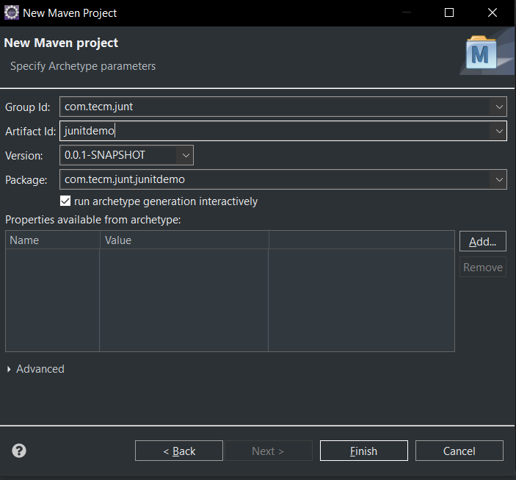
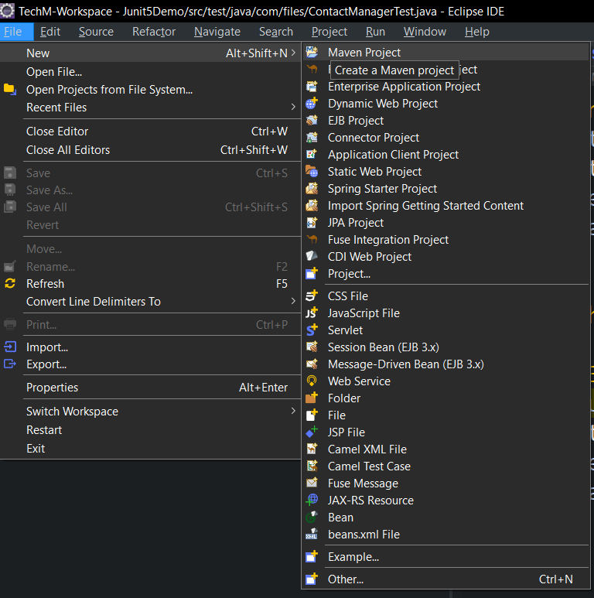
JUnit with Eclipse
JUnit with Eclipse
  Create a new Maven project

Slide 14
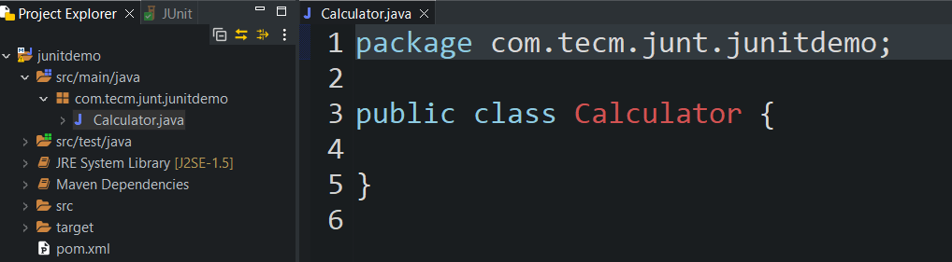
JUnit with Eclipse
JUnit with Eclipse
  Create a new Java class named Calculator.java and write the units(methods) for testing

Slide 15
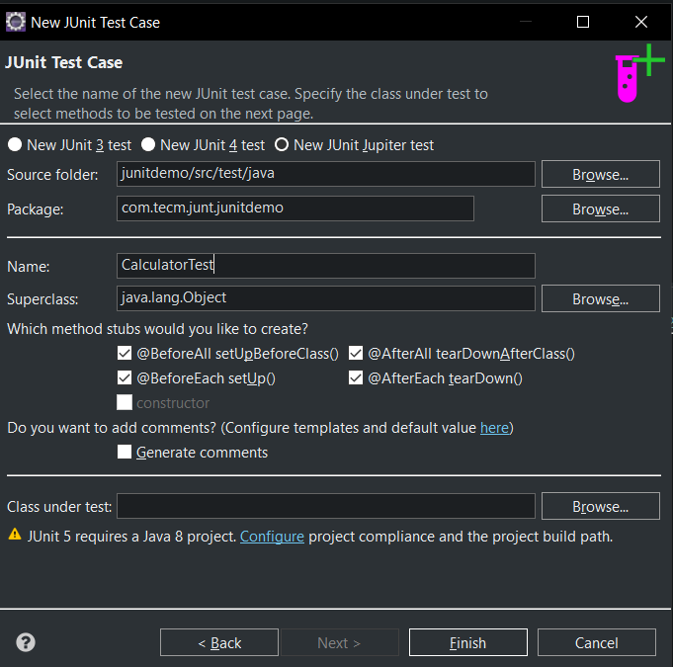
JUnit with Eclipse
JUnit with Eclipse
Right-click on the project in the Package Explorer, then select New -> JUnit Test Case. In the dialog that appears, choose New JUnit Jupiter test, enter CalculatorTest.java as the class name, and make sure to add the JUnit 5 library to the build path

Slide 16
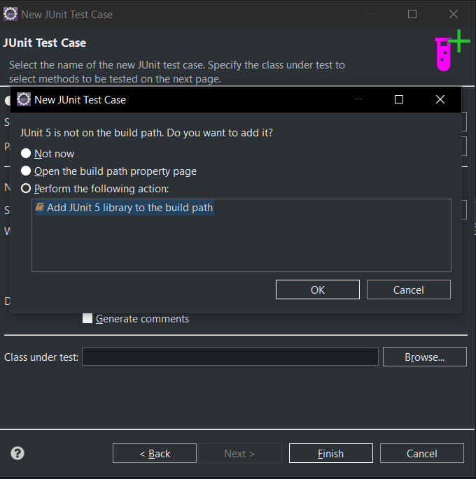
JUnit with Eclipse
JUnit with Eclipse
Right-click on the project in the Package Explorer, then select New -> JUnit Test Case. In the dialog that appears, choose New JUnit Jupiter test, enter CalculatorTest.java as the class name, and make sure to add the JUnit 5 library to the build path

Slide 17
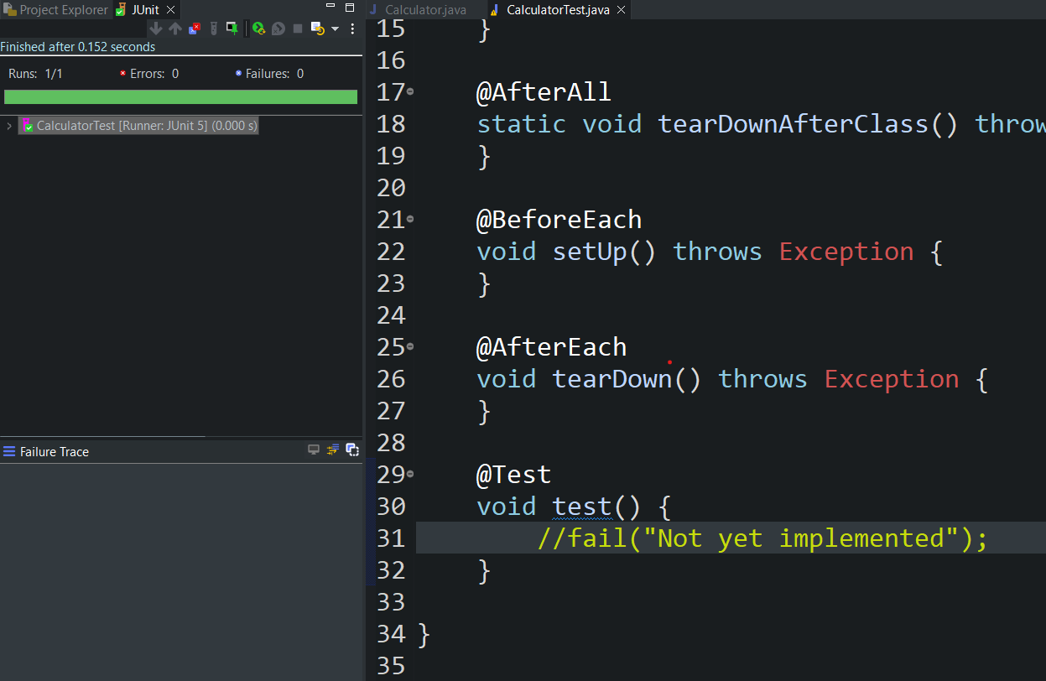
JUnit with Eclipse
JUnit with Eclipse
After writing the test cases, right-click on the test class file and select Run As -> JUnit Test. The test results will be displayed as shown.

Slide 18
JUnit Annotations
Please download pictures in suitable size here and insert them by clicking the symbol above.

Slide 19
Definition
JUnit Annotations
  A special form of syntactic meta-data
  To make Java source code for better code readability and structure.
  Variables, parameters, packages, methods and classes can be annotated.
  Annotations were introduced in Junit4, which makes Java code more readable and simple.

Slide 20
Annotations with explanation
JUnit Annotations
Annotations | Description
@Test | Indicates that public void method to which it is attached can be executed as a test Case.
@BeforeEach | Execute some statement such as preconditions before each test case
@BeforeAll | Execute once before all the test methods in the class .The method must be static.
@AfterEach | Execute some statements after each test case
@AfterAll | Execute once after all the test methods in the class .The method must be static.
@Disabled | Disables a test or test class (i.e., skips its execution).
@RepeatedTest | Executes the test method multiple times
@ParameterizedTest | Marks a test method as parameterized to run with different sets of inputs.
@Nested | Used to create inner test classes, allowing you to logically group related test methods.

Slide 21
JUnit Assertions
Please download pictures in suitable size here and insert them by clicking the symbol above.

Slide 22
Definition
JUnit Assertions
  Assert is a method useful in determining Pass or Fail status of a test case.
  JUnit provides a class named Assert, which provides a bunch of assertion methods useful in writing test cases and to detect test failure.
Assert methods are provided by the class org.junit.Assert which extends java.lang.Object class.

Slide 23
Commonly used Assertions
JUnit Assertions
JUnit Assert methods
-Boolean
-Null object
-Identical
-Assert Equals
-Assert Array Equals
-Fail Message

Slide 24
Boolean
JUnit Assertions
To test the boolean conditions (true or false), you can use following assert methods
      assertTrue(condition)
      assertFalse(condition)
@Test public void testAssert(){ int var1=1; int var2=2; assertTrue(var1<var2); //(1<2) True assertFalse(var1>var2); //(1>2) False }

Slide 25
Null Object
JUnit Assertions
To check the initial value of an object/variable, you have the following methods:
      assertNull(object)
      assertNotNull(object)
@Test public void testAssert(){ String str1="test"; String str2=null; assertNotNull(str1); assertNull(str5); }

Slide 26
Identical
JUnit Assertions
To check whether the objects are identical (i.e. comparing two references to the same java object), or different.
      assertSame(expected, actual)
      assertNotSame(expected, actual)
@Test public void testAssert(){ String str1="test"; String str2="test"; String str3="testing"; assertSame(str1, str1); assertNotSame(str1, str3); }

Slide 27
Assert Equals
JUnit Assertions
To test equality of two objects, you can use the following method
      assertEquals(expected, actual)
@Test public void testAssert(){ String str1="test"; String str2="test"; assertEquals(str1,str2); }

Slide 28
Assert Array Equals
JUnit Assertions
To test equality of two array objects, you can use the following method
      assertArrayEquals(expected, actual)
@Test public void testAssert(){ int[ ] array1= {1,2,3}; int[ ] array2= {1,2,3}; assertArrayEquals(array1,array2); }

Slide 29
Exception Assertions
JUnit Assertions
To throw any assertion error, you have assertThrows().
assertThrows(expectedType, executable, message)
assertDoesNotThrows(expectedType, executable, message)
assertThrows(ArithmeticException.class, () -> { int result = 1 / 0;}, "Division by zero should throw ArithmeticException"); assertDoesNotThrow(() -> { int result = 1 / 1;}, "This should not throw any exception");

Slide 30
Test case and Test suite
Please download pictures in suitable size here and insert them by clicking the symbol above.

Slide 31
Test Case
Test case and Test suite
  It is a set of actions executed to verify a particular feature or functionality of software application behaves as expected
  It includes variables or conditions, used to compare expected and actual results to examine whether a software product is functioning as per the requirements of the customer
  In JUnit, to write a test cases following needs to be followed.
  RULE
  1) All the test methods must be marked with JUnit annotations @Test
  2) Test methods must be marked as “public” methods not to be marked as “private”
  methods
  3)The return type of each test methods should be “void”
  4)The test methods should not start with keywords

Slide 32
Test Case-Example
Test case and Test suite
@Test @DisplayName("Test sum of two positive numbers") void testSumOfPositiveNumbers() { assertEquals(5, calculator.sum(2, 3), "Sum of 2 and 3 should be 5"); }

Slide 33
Test Suite
Test case and Test suite
  It is aggregation all test cases from multiple classes in one place and run it together in single go
  In JUnit to run the suite test, we need to annotate a class using following annotations
@Suite
@SelectClasses({ Test.class,Test1.class.. })
  Steps to run test suite
  Step 1) Create more than one test class and add a method annotated with @test.
  Step 2) To create a testSuite, we need to first annotate the class with @Suite and @SelectClasses(Test.class,Test1.class.. )
  Step 3) Create a AllTests class to run our test suite as given below;

Slide 34
Test Suite - Example
Test case and Test suite
public class CalculatorTest { @Test public void testSetup() { System.out.println("This my first method"); } }
public class StringValidatorTest { @Test public void testSetup() { System.out.println("This my second method"); } }

Slide 35
Test Suite - Example
Test case and Test suite
import org.junit.platform.suite.api.SelectClasses; import org.junit.platform.suite.api.Suite; @Suite @SelectClasses({ CalculatorTest.class, StringValidatorTest.class }) public class AllTests { }

Slide 36
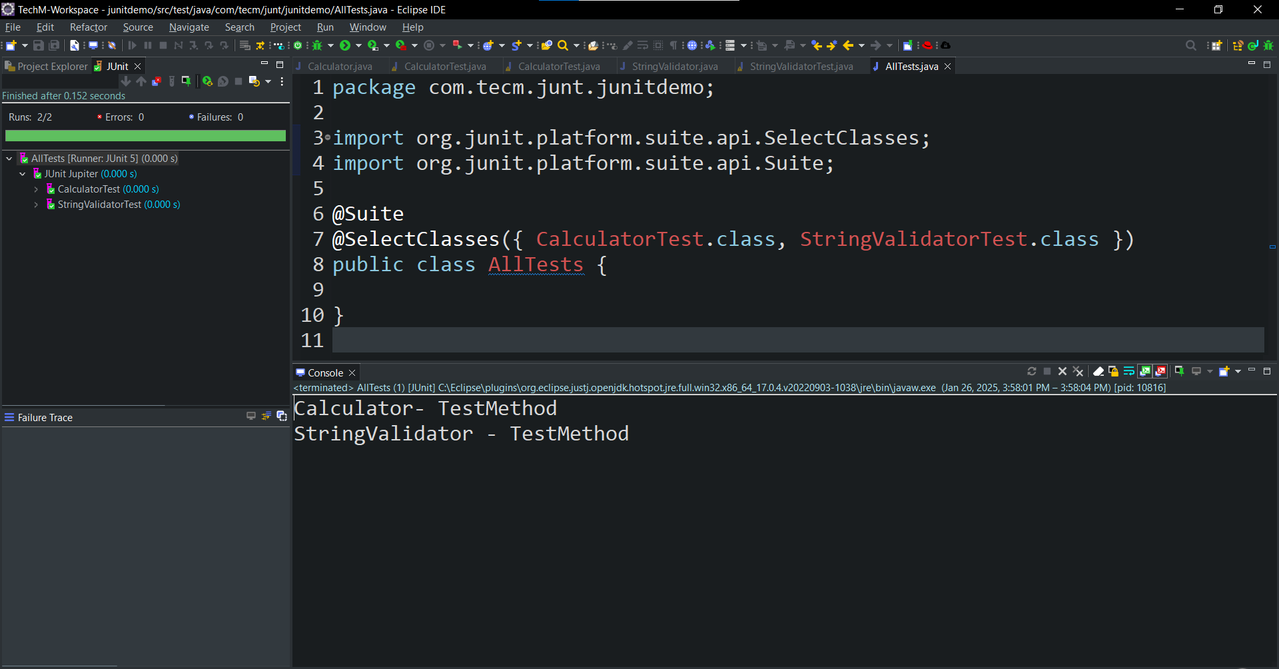
Test Suite - Output
Test case and Test suite

Slide 37
Demo
Please download pictures in suitable size here and insert them by clicking the symbol above.

Slide 38
Problem Statement
Junit
Design and implement a Calculator class with methods to perform basic arithmetic operations, as well as additional utility methods for checking if a number is positive and returning an array of integers.
Requirements:
Arithmetic Methods:
  sum(int a, int b): This method takes two integers as input and returns their sum as an integer.
  subtract(int a, int b): This method takes two integers as input and returns the result of subtracting b from a as an integer.
  multiply(int a, int b): This method takes two integers as input and returns their product as an integer.
  divide(int a, int b): This method takes two integers as input and returns the result of dividing a by b as a double. It should throw an ArithmeticException if division by zero is attempted.
Additional Methods:
  isPositive(int number): This method checks if a given integer is positive (greater than zero). It returns true if the number is positive, and false otherwise.
  getArray(): This method returns a static array of integers {1, 2, 3}.

Slide 39
Problem Statement
.
Junit
Create a set of unit tests for the Calculator class using JUnit 5. The tests should ensure the correctness of basic arithmetic operations and utility methods provided by the Calculator class.
Requirements:
Test Setup: Ensure the Calculator object is initialized before each test and cleaned up after each test.
Test Cases:
  Sum Method :
    Test with positive numbers.
    Test with negative numbers.
    Test with repeated execution (using @RepeatedTest).
  Subtraction Method :
    Test basic subtraction.
    Test subtraction with negative result.
  Multiplication Method :
    Test multiplication of numbers using @ParameterizedTest with a set of values.

Slide 40
Problem Statement
.
Junit
  Division Method :
    Test division with a non-zero denominator.
    Test division by zero (should throw an ArithmeticException).
  Utility Methods :
    Test the isPositive method with multiple values.
    Test the getArray() method to ensure it returns the expected array.
  Edge Cases :
    Handle edge cases such as division by zero and test array equality

Slide 41
Example
JUnit
public class CalculatorTest { private Calculator calculator; @BeforeAll public static void initAll() { System.out.println("Initializing resources for all tests..."); } @AfterAll static void cleanUpAll() { System.out.println("Cleaning up resources after all tests..."); } @BeforeEach void setUp() { System.out.println("Setting up for the test..."); calculator = new Calculator(); } @AfterEach void tearDown() { System.out.println("Tearing down after the test..."); }

Slide 42
Example
JUnit Annotations
@Test @DisplayName("Test sum of two positive numbers") void testSumOfPositiveNumbers() { assertEquals(5, calculator.sum(2, 3), "Sum of 2 and 3 should be 5"); } @Test @DisplayName("Test sum of two negative numbers") void testSumOfNegativeNumbers() { assertEquals(-5, calculator.sum(-2, -3), "Sum of -2 and -3 should be -5"); } @RepeatedTest(3) @DisplayName("Test sum with repeated execution") void testSumRepeated( RepetitionInfo repetitionInfo) { System.out.println("Running testAdditionRepeatedly... Repetition: " + repetitionInfo.getCurrentRepetition()); assertEquals(10, calculator.sum(5, 5), "Sum of 5 and 5 should be 10"); }

Slide 43
Example
JUnit Annotations
@Nested @DisplayName("Subtraction Tests") class SubtractionTests { @Test @DisplayName("Test subtraction of two numbers") void testSubtraction() { assertEquals(1, calculator.subtract(5, 4), "5 - 4 should be 1"); } @Test @DisplayName("Test subtraction with negative result") void testSubtractionNegative() { assertEquals(-1, calculator.subtract(4, 5), "4 - 5 should be -1"); } }

Slide 44
Example
JUnit Annotations
@ParameterizedTest @ValueSource(ints = { 1, 2, 3, 4, 5 }) @DisplayName("Test multiplication of numbers by 2") void testMultiplyByTwo(int number) { assertEquals(number * 2, calculator.multiply(number, 2), "Multiplying by 2 should return correct result"); } @Test @DisplayName("Test division with non-zero denominator") void testDivide() { assertEquals(2.0, calculator.divide(10, 5), "10 divided by 5 should be 2"); } @Test @DisplayName("Test division by zero") void testDivideByZero() { assertThrows(ArithmeticException.class, () -> calculator.divide(10, 0), "Division by zero should throw ArithmeticException"); }

Slide 45

Quiz
JUnit
What should be the return type of JUnit methods ?
a) int
b) void
c) string
d) object
b) void

Slide 46
Quiz
Java Database Connectivity (JDBC)
2. Testing is defined as testing of single entity (class or method) ?
a) True
b) False
a) True

Slide 47
Quiz
JUnit
3. Which of the following class is a Composite of Tests ?
a) Test cases
b) Composite Test
c) Test Suite
d) Asserts
c) Test Suite

Slide 48
Quiz
JUnit
4. Which of the annotations of Assert class checks a condition is false ?
a) void assertEquals(cond)
b) void assertFalse(cond)
c) void assertTrue(cond)
d) void assertChecks(cond)
b) void assertFalse(cond)

Slide 49
Quiz
JUnit
5. Which of the following annotation in JUnit specifies the public void method to run a test case ?
a) @Test
b) @BeforeClass
c) @BeforeSuite
d) @BeforeTest
a) @Test

Slide 50
Quiz
JUnit
6. What does assertSame() method use for assertion?
a) Equals(cond)
b) Same(cond1,cond2)
c) =
d) ==
d) ==

Slide 51
Quiz
JUnit
7. Guess the output
@Test
public void testAssert() {
String message = “Hello”;
assertEquals(3,message.length());
}
a) Runtime Error
b) Test Ran and passed
c) Test Ran and failed
d) Compilation Error
c) Test Ran and failed

Slide 52
Quiz
Java Database Connectivity (JDBC)
8. Is assert a keyword in Java ?
a) True
b) False
a) True

Slide 53
Quiz
JUnit
9. Which methods cannot be tested by JUnit test class?
a) public methods
b) protected methods
c) private methods
d) void return methods
c) private methods

